Slide 1
Web Development Udemy course

Slide 2
Trinity of Front end
HTML , CSS , Java Script : These three are front end for any web page .
HTML : Hyper Text Mark up language : Basis skeleton
CSS : Cascading the style sheets : Adds skin to HTML skeleton
Java Script : Adds logic and inter activity etc to a web page
Code pen site : https://codepen.io/
Log in with github account.
MDN : Mozilla developers network
https://developer.mozilla.org/en-US/docs/Learn/HTML/Introduction_to_HTML

Slide 3
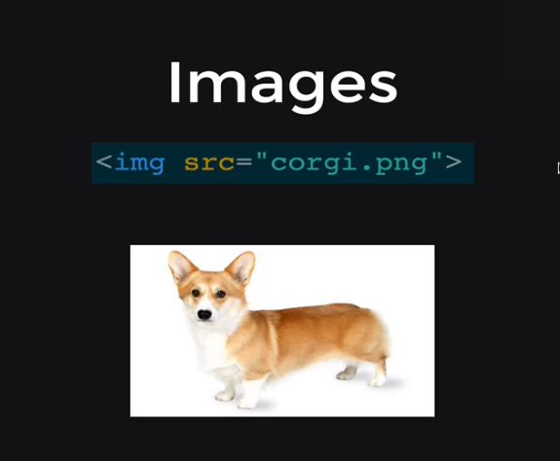
HTML image tag

Slide 4
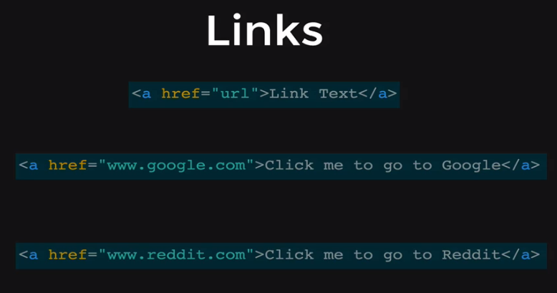
Links anchor tag

Slide 5
Html tables

Slide 6
Forms
<br> - This is a line break tag , just adds a new line to the html page
<from </from> - This is standard form tag that holds different graphical objects to create
We form.
<label></label>

Slide 7
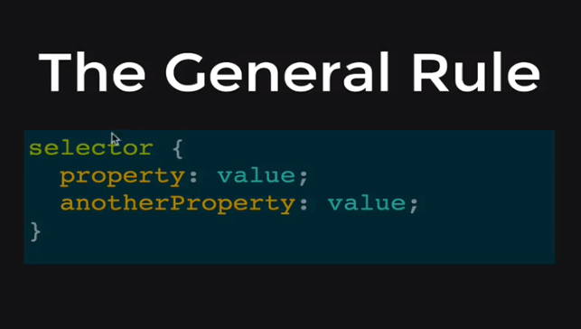
CSS – Cascading Style Sheets
CSS Zen Garden : http://www. csszengarden.com/
Here the selector is nothing but a html tag that requires styling. Properties are the
Attributes that are set with a value to get the desired design effect. The file app.css has the code
For the styling. The link in the html file connects with this file with the above code

Slide 8
Css colours
It is possible to use primary colors with names
Example color: red;
Using colorpicker we can give a 6 digit hexadecimal number
Example color : #FF5301
Using rgb (0,255,10) Example color : rgb (0,255,0)

Slide 9

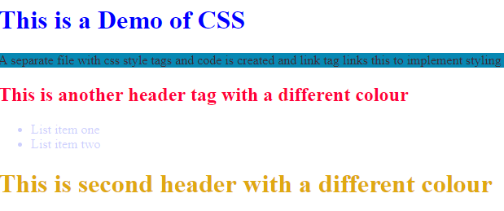
Two same type of tags can have different colors
In html file, the header line is given with an id = ‘second_h1’
In css file the id is used to set its properties
As a result of this we can see two headers with different colors set as required.

Slide 10
Changing something here to see the effect

